Slide 1


Minor Project
Title:
UniForum
Presented by:
Jayendra Vardhan Singh, R214220566, CSE CCVT
Harshit Sharma, R214220494, CSE AIML
Gourav, R214220466,CSE CCVT
Yugal Agarwal, R2142201623,CSE AIML Hons.
Guided by:
Dr. Deepika Koundal
Associate Professor
Systemics Cluster
School of Computer Science

Slide 2
Content
Introduction
Problem Statement
Objectives
Tech Stack
Methodology
SWOT Analysis
Application of the Project
PERT Chart
Objectives Covered
References

Slide 3
1. Introduction
Bring people with common interests together and foster a sense of community.
Members can share their knowledge and experiences with each other and learn from each other.
Provide a space for members to ask questions and receive answers and solutions to problems.
Facilitate communication between members, allowing for the exchange of ideas and feedback.

Slide 4
2. Problem Statement
The current forum lacks engagement and user participation, leading to a lack of meaningful discussions and valuable content. Users are not incentivized to contribute and there is a need to improve the overall user experience to increase engagement and build a stronger community.

Slide 5
3. Objectives
To authorize user
Send threads anonymously
To implement discussion forum

Slide 6
4. Technology Stack
Version Control
Github
Development
Backend - php
Frontend – HTML,CSS
Deployment
Docker
Database
Amazon RDS for SQL Server
Apache

Slide 7
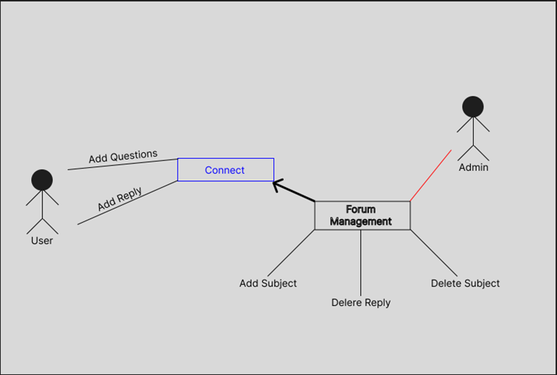
5. Methodology
Fig.1 Use Case Diagram

Slide 8
6. SWOT Analysis
Strengths:
Provides a centralized and reliable platform to connect and collaborate.
Supports student engagement and learning outcomes by promoting peer-to-peer communication, knowledge sharing.
Fosters social and emotional learning by providing a space for students to express their thoughts and feelings.
Weaknesses:
May face competition from existing online forum platforms.
Will require ongoing maintenance and updates to ensure optimal performance and security.
Will need to actively check for the students and provide them the proper features
Opportunities:
Can be expanded to include additional features and functionality, such as chat, video conferencing, and document sharing.
Can be customized to meet the specific needs of different educational institutions and programs.
Can be monetized through subscription fees or advertising partnerships.
Threats:
May face data privacy and security concerns, which could impact user trust and adoption.
May face challenges in maintaining a vibrant and engaged user community over time.

Slide 9
7. Application of the Project
Classroom collaboration: The Student Forum can provide a space for students to collaborate on assignments, discuss class topics, and exchange feedback and ideas. This can promote student engagement and learning outcomes by providing a space for peer-to-peer communication and knowledge sharing.
Distance learning: The Student Forum can be used as a key tool for facilitating online learning, providing a space for students to connect with one another and engage in discussions and collaborative learning activities. This can help to bridge the distance between students and create a sense of community in an online learning environment.
Student support and well-being: The Student Forum can provide a space for students to express their thoughts and feelings and seek support from their peers. This can help to foster social and emotional learning and promote student well-being by providing a safe and supportive space for students to connect with one another.
Institutional communication: The Student Forum can be used as a tool for institutional communication, providing a space for students to stay up-to-date on campus news and events, and connect with faculty and staff.

Slide 10
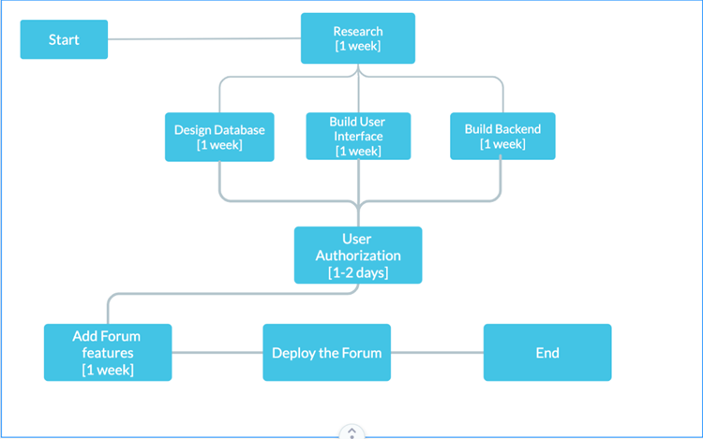
8. PERT Chart
Fig.2 Pert chart

Slide 11
9. Objectives Covered
Objectives | Status
Learning the technologies used | done
To authorize user | In process
Send threads anonymously | In process
To implement discussion forum | In process

Slide 12
10. Bibliography
[1] Arpita Ghosh and Jon Kleinberg. 2018. Incentivizing participation in online forums for education. In Proceedings of the fourteenth ACM conference on Electronic commerce (EC '13). Association for Computing Machinery, New York, NY, USA, 525–542.
[2] Kaur, M. (2011). "Using Online Forums in Language Learning and Education." Inquiries Journal/Student Pulse, 3(03).
[3] Ravi Seethamraju, "Effectiveness of Using Online Discussion Forum for Case Study Analysis", Education Research International, vol. 2014, Article ID 589860, 10 pages, 2014.

Slide 13
Thank You

